Slide 1

“Diabetes Prediction Using Machine Learning”
NIELIT Imphal, Deemed to be University
Under the Guidance of
Dr. Usham Sanjota Devi
Assistance Professor
Heisnam Kavit Singh
MTech-AI NDU202400083

Slide 2
Contents
Abstract
Introduction
Objective
Drawback Existing System
Literature Review
Methodology
Flow Diagram
Implementation
Conclusion

Slide 3
Abstract
This project explores the use of machine learning techniques for predicting diabetes risk using patient health data. Four algorithms—K-Nearest Neighbors (KNN), Naive Bayes, Random Forest, and Logistic Regression—were implemented and compared on a dataset of 768 individuals.
After preprocessing, the data was split into 80% training and 20% testing sets. Model performance was evaluated using accuracy, precision, recall, and F1-score.
Results showed that Naive Bayes achieved the highest accuracy (77%), followed by Logistic Regression (76%), KNN (75%), and Random Forest (74%). This study highlights the potential of machine learning in developing effective tools for early diabetes detection and better healthcare decision-making.

Slide 4
Introduction
Diabetes is a chronic metabolic disorder characterized by elevated blood glucose levels, affecting millions of people worldwide. Early detection and intervention are crucial for managing the disease and preventing complications. In recent years, machine learning techniques have shown promising results in predicting diabetes risk, offering potential for improved screen and preventive care.

Slide 5
Objective
The primary objective of this study is to develop and compare machine learning models for predicting diabetes risk using patient heath data.
We aim to implement four algorithms: Naïve Bayes, K-Nearest Neighbors (KNN), Decision tree, and logistic regression and evaluate their performance in terms of Accuracy, Precision, Recall and F1 – Score.
This project focuses on predicting diabetes risk using machine learning techniques to support early diagnosis and improve healthcare outcomes.

Slide 6
Drawback of Existing System
Diabetes prediction in many healthcare settings relies on traditional diagnostic methods, such as blood sugar tests and manual assessment of patient history. While these methods are essential, they often depend on periodic testing and may not always catch early warning signs of diabetes, especially in high-risk individuals without obvious symptoms.
In some systems, basic statistical models are used for risk assessment, but they may not fully capture complex relationships between multiple health factors. Additionally, most traditional screening processes are time-consuming, require significant human effort, and may miss subtle patterns hidden in large datasets
This project focuses on predicting diabetes risk using machine learning techniques to support early diagnosis and improve healthcare outcomes.

Slide 7
Literature Review
In recent years due to their potential to improve early diagnosis and patient outcomes for Diabetes. This review summarizes key studies and findings in the field, focusing on the application of Naive Bayes, K-Nearest Neighbors (KNN), Decision Tree, and Logistic Regression algorithms.
Sisodia and Sisodia (2018) compared Naive Bayes, Decision Tree, and SVM for diabetes prediction, finding that Naive Bayes outperformed other algorithms with an accuracy of 76.30%. Their study highlighted the efficiency of Naive Bayes in handling the complexities of medical data.

Slide 8
Literature Review
Zou et al. (2018) utilized KNN for diabetes prediction, achieving an accuracy of 93.5% in their best model. They emphasized the importance of feature selection and data preprocessing in improving model performance.
Perveen et al. (2016) explored the use of Decision Trees for diabetes prediction, achieving an accuracy of 72.3%. Their study highlighted the interpretability of Decision Tree models, providing insights into the most critical factors for diabetes risk.
Kandhasamy and Balamurali (2015) compared Logistic Regression, Decision Tree, and Random Forest algorithms for diabetes prediction. They found that Logistic Regression performed well, with an accuracy of 75.32%, and noted its ability to provide probability estimates for risk assessment.

Slide 9




Methodology
Data Collection
Pima Indians diabetes dataset used, E.g. Glucose, insulin, Pregnancies…. etc
Data Preprocessing
Pima Indians diabetes database requires several step to handle missing values & train model
Feature Extraction
In the stage it pick only Importance Data
Data Partitioning
Dataset is splitting into two parts i.e. Training and Testing.
Model Fitting & Evaluation
5
Algorithms used: Logistic Regression, Decision Tree, Random Forest, etc.
Metrics: Accuracy, Precision, Recall, F1-score,
Prediction & Interpretation
6
Final predict outcome

Slide 10
Flowchart
KNN
NB
RF
LP
Diabetes
Diabetes
Data
Data Cleaning
Features Extraction
Machine Learning
Classification
Non
Diabetes
Training / Testing

Slide 11
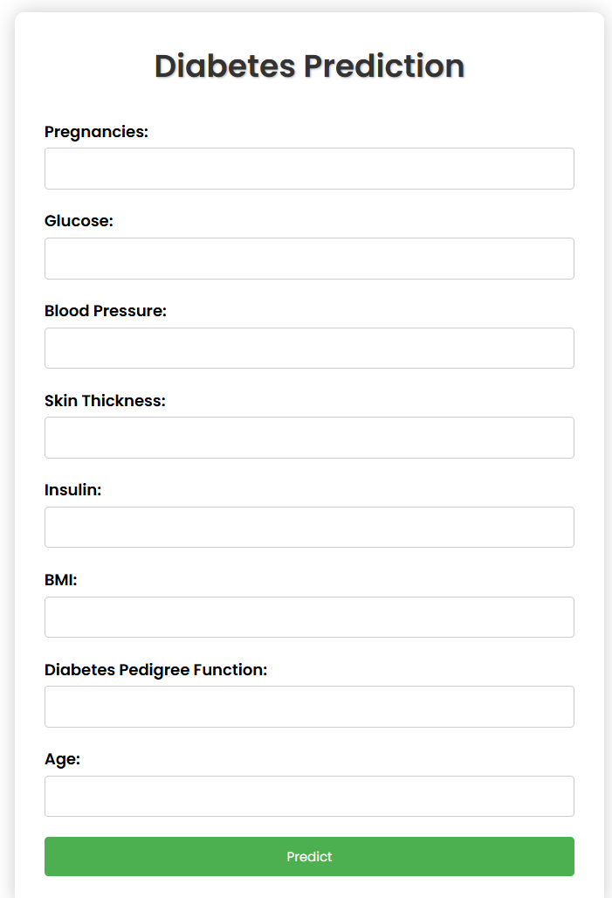
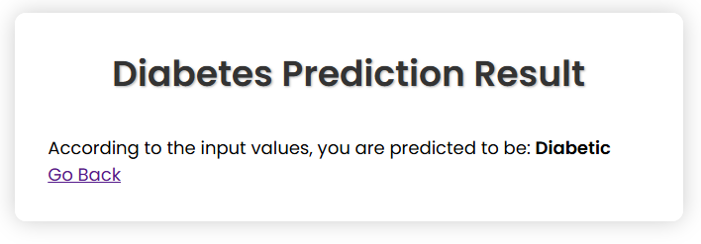
Implementation

Slide 12
Conclusion
The project shows how AI can transform diabetes care. Using diverse data and ethical AI helps give personalized treatment. Predictive analytics help doctors and patients make smarter decisions. With ongoing research, we can enter a new era of precision medicine - treatments made just for us.

